Slide 1
US Commercial Roll-Out of alfapump® System
KOL Webinar
January 8, 2025
Euronext: SEQUA.BR

Slide 2
Disclaimers
Important Notice
IMPORTANT: You must read the following before continuing. The following applies to this document, the oral presentation of the information in this document by Sequana Medical NV (the "Company") or any person on behalf of the Company, and any question-and-answer session that follows the oral presentation:
This presentation has been prepared by the management of the Company. It does not constitute or form part of, and should not be construed as, an offer, solicitation or invitation to subscribe for, underwrite or otherwise acquire, any securities of the Company or any member of its group nor should it or any part of it form the basis of, or be relied on in connection with, any contract to purchase or subscribe for any securities of the Company or any member of its group, nor shall it or any part of it form the basis of or be relied on in connection with any contract or commitment whatsoever. Prospective investors are required to make their own independent investigations and appraisals of the business and financial condition of the Company and the nature of its securities before taking any investment decision with respect to securities of the Company. This presentation is not a prospectus or offering memorandum.
The information included in this presentation has been provided to you solely for your information and background and is subject to updating, completion, revision and amendment and such information may change materially. No person is under any obligation or undertaking to update or keep current the information contained in this presentation and any opinions expressed in relation thereto are subject to change without notice. No representation or warranty, express or implied, is made as to the fairness, accuracy, reasonableness or completeness of the information contained herein. Neither the Company nor any other person accepts any liability for any loss howsoever arising, directly or indirectly, from this presentation or its contents.
The presentation also contains information from third parties. Third party industry publications, studies and surveys may also contain that the data contained therein have been obtained from sources believed to be reliable, but that there is no guarantee of the accuracy or completeness of such data. While the Company reasonably believes that each of these publications, studies and surveys has been prepared by a reputable source, the Company, or any of their respective parent or subsidiary undertakings or affiliates, or any of their respective directors, officers, employees, advisers or agents have independently verified the data contained therein. Thus, while the information from third parties has been accurately reproduced with no omissions that would render it misleading, and the Company believes it to be reliable, the Company cannot guarantee its accuracy or completeness. In addition, certain of the industry and market data contained in this presentation comes from the Company's own internal research and estimates based on the knowledge and experience of the Company's management in the market in which the Company operates. While the Company reasonably believes that such research and estimates are reasonable and reliable, they, and their underlying methodology and assumptions, have not been verified by any independent source for accuracy or completeness and are subject to change without notice. Accordingly, undue reliance should not be placed on any of the industry, market or competitive position data contained in this presentation.
This presentation includes forward-looking statements that reflect the Company's intentions, beliefs or current expectations concerning, among other things, the Company's results, condition, performance, prospects, growth, strategies and the industry in which the Company operates. These forward-looking statements are subject to risks, uncertainties and assumptions and other factors that could cause the Company's actual results, condition, performance, prospects, growth or opportunities, as well as those of the markets it serves or intends to serve, to differ materially from those expressed in, or suggested by, these forward-looking statements. These statements may include, without limitation, any statements preceded by, followed by or including words such as "target," "believe," "expect," "aim," "intend," "may," "anticipate," "estimate," "plan," "project," "will," "can have," "likely," "should," "would," "could" and other words and terms of similar meaning or the negative thereof. The Company cautions you that forward-looking statements are not guarantees of future performance and that its actual results and condition and the development of the industry in which the Company operates may differ materially from those made in or suggested by the forward-looking statements contained in this presentation. In addition, even if the Company's results, condition, and growth and the development of the industry in which the Company operates are consistent with the forward-looking statements contained in this presentation, those results or developments may not be indicative of results or developments in future periods. The Company and each of its directors, officers and employees expressly disclaim any obligation or undertaking to review, update or release any update of or revisions to any forward-looking statements in this presentation or any change in the Company's expectations or any change in events, conditions or circumstances on which these forward-looking statements are based, except as required by applicable law or regulation.
This document and any materials distributed in connection with this document are not directed to, or intended for distribution to or use by, any person or entity that is a citizen or resident of, or located in, any locality, state, country or other jurisdiction where such distribution, publication, availability or use would be contrary to law or regulation or which would require any registration or licensing within such jurisdiction. The distribution of this document in certain jurisdictions may be restricted by law and persons into whose possession this document comes should inform themselves about, and observe any such restrictions.
The Company's securities have not been and will not be registered under the US Securities Act of 1933, as amended (the "Securities Act"), and may not be offered or sold in the United States absent registration under the Securities Act or exemption from the registration requirement thereof.
By attending the meeting where this presentation is presented or by accepting a copy of it, you agree to be bound by the foregoing limitations.
General disclaimer:
Sequana Medical is closely following the evolution of macroeconomic conditions, the geopolitical situation in Ukraine and the middle east and is in constant dialogue with its partners to assess the impact and adapt operations accordingly.
Sequana Medical will continue to update the market as needed and whenever possible.
Note:
alfapump® and DSR® are registered trademarks.

Slide 3
Disclaimers (cont’d)
Important Notice
IMPORTANT: You must read the following before continuing. The following applies to this document, the oral presentation of the information in this document by Sequana Medical NV (the "Company") or any person on behalf of the Company, and any question-and-answer session that follows the oral presentation:
Indication for Use: The alfapump® System is intended for single patient use only in adult patients with refractory or recurrent ascites due to liver cirrhosis. It is indicated for the removal of excess peritoneal fluid from the peritoneal cavity into the bladder, where it can be eliminated through normal urination.
Contraindications: The alfapump® System is MRI unsafe. Hyperbaric oxygen therapy is contraindicated.
Warnings, Risks, and Precautions: Consider risks associated with implanting the alfapump® System including risk of peritoneal cavity infections, Coagulopathy, Small bladder capacity and/or obstructive uropathy. The following procedures or therapies could impact the alfapump® System function: Supersonic therapy and high-frequency heat therapy, Transcutaneous Electrical Nerve Stimulation (TENS), Lithotripsy, Defibrillation, Radiation therapy, Electrocautery, or use of other implantable medical devices and wearable devices.
Adverse Events: In addition to procedure related risks the following Adverse Events may occur: pump pocket hematoma, skin erosion, infection, pump migration, catheter clogging or other catheter complications resulting in tissue damage or loss of or change in therapy, genito-urinary complications, reduced kidney function, hepatic encephalopathy, progression of liver disease, and other systemic effects.
P230044 PMA approval letter on file
U.S. Federal law restricts alfapump System to sale by or on the order of a physician.
The alfapump® System is currently not approved in Canada.
DSR® therapy is still in development and is currently not approved in any country. The safety and effectiveness of DSR® therapy has not been established

Slide 4
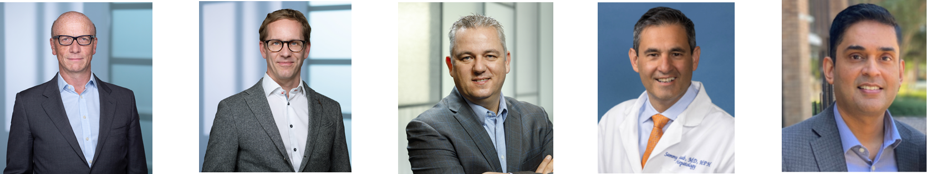
Presenters
alfapump® US commercialisation plans
Ian Crosbie
Chief Executive Officer
Sequana Medical NV
Dr Klarenbeek
Chief Medical Officer
Sequana Medical NV
Martijn Blom
Chief Commercial Officer
Sequana Medical NV
Dr Saab
Professor of Medicine & Surgery,
David Geffen School of Medicine, UCLA
Dr Pagadala
Transplant Hepatologist,
Methodist Dallas Medical Center

Slide 5
US Commercial Roll-Out of alfapump®
Introduction | Ian Crosbie, CEO
Recurrent and Refractory Ascites Due to Liver Cirrhosis – Overview and treatment overview | Dr Saab, UCLA
POSEIDON & Patient Preference Studies | Dr Gijs Klarenbeek, Chief Medical Officer
What the POSEIDON results mean for patients and physicians, and experience from the POSEIDON study | Dr Pagadala, Methodist Dallas Medical Center
US market opportunity & Commercial Roll-Out Plans | Martijn Blom, Chief Commercial Officer
Wrap Up | Ian Crosbie, CEO
Q&A | All

Slide 6
Introduction
Ian Crosbie,
CEO

Slide 7
Focus on alfapump US commercialisation
Sequana Medical Financing Will be Focused on alfapump® Commercialisation in the US
alfapump
US FDA approved device for recurrent & refractory ascites due to liver cirrhosis
Strategic objective is successful US commercialisation
Focus of Sequana Medical activities & financing at public company level
DSR
Drug development program for cardiorenal syndrome & diuretic resistance in heart failure
Clinical proof of concept published in European Journal of Heart Failure
  100% owned subsidiary (“DSR Co”)
  Future financing planned through private financing at DSR Co level

Slide 8
alfapump – highly attractive US opportunity
US PMA approval in large and growing market with attractive dynamics and direct specialty sales model
Recurrent and Refractory Liver Ascites - $2 billion market with 9% CAGR driven by MASH/NASH & alcoholic liver disease
Potential to Transform Underserved Market – Clear unmet clinical needs from standard of care that is not defended by commercial player, and no competitive devices in development
Strong Clinical Message – POSEIDON pivotal study clearly met efficacy and safety end points
Derisked Reimbursement – Existing coding, together with NTAP and focus on specialist centers
Direct Specialty Sales Model Launching H2 2025 - Small specialty salesforce focused on liver transplant centers
Positive Market Feedback – Clear need for improved treatment options from clinicians & patients
Platform for Sustained Market Leadership – Real long term barriers to direct competitors from PMA and FDA Breakthrough Device Designation, plus granted IP and extensive know-how
Established and Experienced Leadership – Derisking scale-up & commercial rollout

Slide 9
US Approval Received⁽¹⁾ – US Launch Planned for H2 25
Broad Indication for Use, Minimal Contraindications and No Post Approval Study Requirements
The alfapump® system is intended for single patient use only in adult patients with refractory or recurrent ascites due to liver cirrhosis.
It is indicated for the removal of excess peritoneal fluid from the peritoneal cavity into the bladder, where it can be eliminated through normal urination.
Contraindications:
i) The alfapump® System is MRI unsafe, and
ii) Hyperbaric oxygen therapy is contraindicated
No post approval study requirements
Plan for structured collection of real world data ongoing – required to drive adoption, support additional publications and expand reimbursement
https://www.accessdata.fda.gov/scripts/cdrh/cfdocs/cfpma/pma.cfm?id=P230044

Slide 10
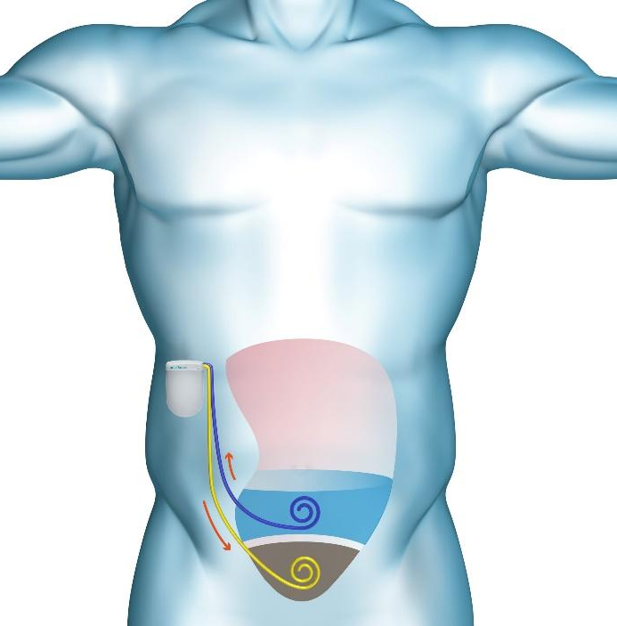
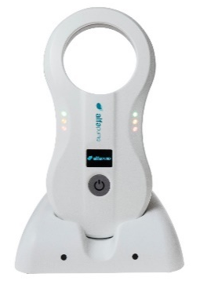


Proven step change in therapy, over 1,000 implanted
Fully implanted automatic device for long term treatment
Wireless battery charging
Settings wirelessly adjusted
Automatic Operation
Long-term implantation
Regular reporting to clinicians
Integrated pressure sensors
PMA Approval from FDA⁽¹⁾
Breakthrough Device
Designation
⁽²⁾
(1) https://www.accessdata.fda.gov/scripts/cdrh/cfdocs/cfpma/pma.cfm?id=P230044
(2) Under MDR 2017/745

Slide 11
Recurrent and Refractory Ascites Due to Liver Cirrhosis –overview and treatment options
Dr Saab,
UCLA

Slide 12
Cirrhosis - Epidemiology
Dr. Saab, UCLA
Affects ~2.2 million adults in US¹
  Continues to rise due to increased incidence of alcohol liver disease and steatotic liver disease
  > 40,000 progress to liver failure and death each year²
1. Tapper and Parikh 2023; 2. NIAAA surveillance report 2022
Notes:
Cirrhosis affects approximately 2.2 million adults in the United States.
And this number continues to rise due to increased incidence of alcohol liver disease and steatotic liver disease.
More than 40,000 patients with cirrhosis progress to liver failure and death each year.

Slide 13
Ascites is a main complication of cirrhosis
Dr. Saab, UCLA
Cirrhosis
Portal Hypertension
Additional complications
Hepatic encephalopathy (HE)
Gastrointestinal/variceal bleeding
Circulatory failure
Ascites
Dilutional Hyponatremia
Acute Kidney Inury (AKI) / Hepatorenal Syndrome (HRS)
Spontaneous Infections
(e.g. spontaneous bacterial peritonitis)
Figure adapted from Biggins et al. 2021
Notes:
In patients with cirrhosis, complications occur due to portal hypertension.
Ascites is actually the main complication, and the landmark of progression into the decompensated phase of cirrhosis.
[CLICK]
Ascites generally presents with the potential for spontaneous bacterial peritonitis, can lead to dilutional hyponatremia and in some circumstances acute kidney injury or AKI, or hepatorenal syndrome, or HRS.
These complications are not mutually exclusive, with many patients experiencing a range of issues at any given time.

Slide 14
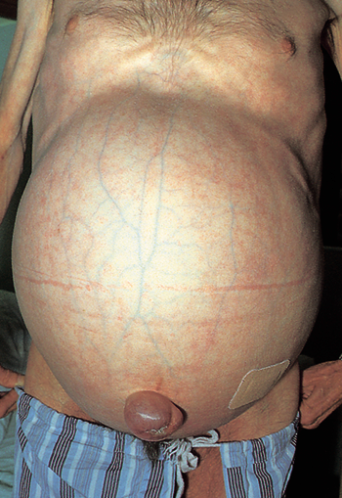
Unmet need for effective treatment to reduce need for repeated invasive procedures
Dr. Saab, UCLA
Patients continue to suffer debilitating symptoms and poor QoL
One-year mortality is high so QoL is key in evaluation of therapeutic interventions
Need effective treatment that will reduce need for repeated invasive procedures, improve day to day symptoms, and allow patients to lead more independent, fulfilled life
Photograph courtesy of Dr. F. Wong, University of Toronto
Notes:
Furthermore, with current standard of care treatment, patients with recurrent or refractory ascites continue to suffer from debilitating symptoms and poor quality of life.
There simply is no ideal management for these patients. Every treatment option we consider has its own benefit-risk profile that must be considered in light of a patient’s specific situation.
Given the high median 1-year mortality in patients with refractory ascites, quality of life is key in the evaluation of therapeutic interventions.
[CLICK]
We need effective treatment that will reduce the need for repeated invasive procedures, improve day to day symptoms, and allow patients to lead a more independent and fulfilled life.
[PAUSE]
Thank you. I now invite Dr. Klarenbeek to present.

Slide 15
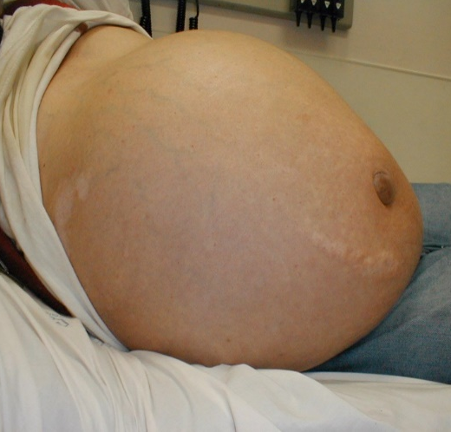
Patients with ascites suffer debilitating symptoms & poor quality of life
Dr. Saab, UCLA
Major Impact on Quality of Life
Perceived stigma associated with adverse attitudes and behaviors¹
    Increased depression
Early satiety, anorexia, nausea
Frailty, sarcopenia
Withdrawal from society
Infection
risk
Caregiver Burden^{2,3}
    Provide transportation and support for medical appointments
    Help with routine activities of living
    ~9 hours per week
Stigma, depression
Swelling, tension
Difficulty breathing
Hernia
Inability
to
move
Poor balance
(fall risk)
1. Vaughn-Sandler et al. 2013
Figure adapted from Jalal et al. EASL 2018
; 2. Rakoski et al. 2012; 3. Lai et al. 2019
Notes:
In addition to all the complications that patients with cirrhosis may experience, patients with recurrent or refractory ascites also suffer from debilitating symptoms and poor quality of life.
They suffer from generalized abdominal distention that frequently causes significant pain, early satiety, nausea, shortness of breath, hernias, and constipation.
They are also prone to electrolyte abnormalities and nutritional deficiencies that lead to subsequent clinical decline.
[CLICK]
As if this wasn’t bad enough, perceived stigma is common among patients with cirrhosis, and is associated with adverse attitudes and behaviors such as increased depression and withdrawal from society.
[CLICK]
Patients often need a caregiver to drive them to their frequent medical appointments due to hepatic encephalopathy, and up to one-third experience impairment in their activities of daily living due to frailty.
As a result, a typical patient with cirrhosis requires approximately 9 hours per week of informal caregiving by friends and family.
So as you can imagine, these patients are miserable much of the time and have a very poor prognosis.

Slide 16
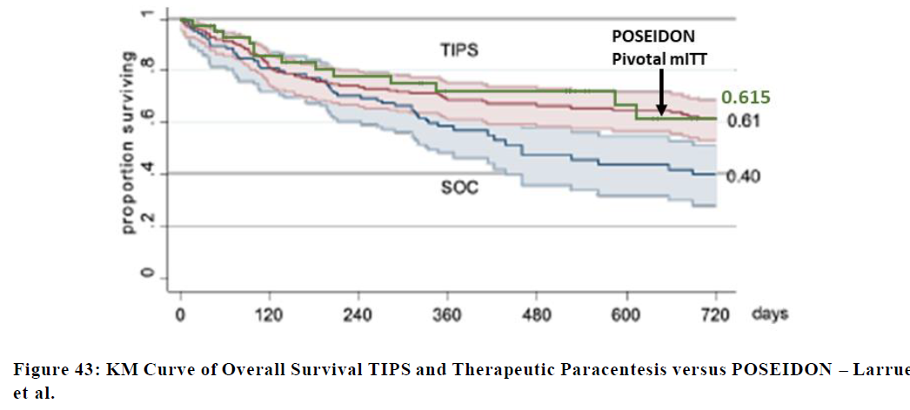
Survival in patients with refractory ascites declines rapidly
Dr. Saab, UCLA
Transjugular Intrahepatic Portosystemic shunt (TIPS)
61%
Proportion Surviving
Large Volume Paracentesis (LVP)
40%
At risk
Days
TIPS
169
138
125
114
83
77
72
SOC
104
84
73
61
25
23
21
Adapted from Larrue 2023; Cross-study comparison
Notes:
Survival in patients with refractory ascites declines very rapidly.
Shown here are the outcomes reported in a recent 2023 meta-analysis from Larrue, of patients with refractory ascites receiving TIPS or standard of care, which was large volume paracentesis. I will get into more detail on these treatments in the next few slides.
The meta-analysis reported a survival rate of 61% in the TIPS group, shown in red, and 40% for standard of care, shown in green, at 2 years follow-up.
The primary reason survival is so poor…

Slide 17
Treatment options for recurrent / refractory ascites
Dr. Saab, UCLA
Liver transplant
ONLY
CURE
Large Volume Paracentesis (> 5L)
FIRST
LINE
Transjugular intrahepatic portosystemic shunt (TIPS)
SECOND
LINE
Notes:
….is that the only proven CURE for ascites associated with liver dysfunction is liver transplantation. And, unfortunately it is only available for a small sector of the population due to limited organ availability, compounded by very specific eligibility criteria. If a patient can get transplant, they should. For the rest there is LVP or TIPS. This becomes a personal choice with different risks. There is a need for additional options
Every other treatment is patient management or palliative care.
[CLICK]
Large volume paracentesis is first line treatment.
[CLICK]
The secondary treatment option is transjugular intrahepatic portosystemic shunt placement, or TIPS.
Let me speak to both of these options in more detail…

Slide 18
LVP is first-line treatment
Dr. Saab, UCLA
Direct aspiration of > 5 L of ascites¹
Invasive, time consuming, and costly
  In-hospital or outpatient clinic
  Simultaneous administration with IV albumin solution¹
Risk of paracentesis-induced circulatory dysfunction (PICD)²
  Severe complication associated with faster re-accumulation of ascites, hyponatremia, renal impairment, and shorter survival³
Repeated frequently (average every 10-14 days⁴)
  High proportion of days with debilitating symptoms between treatments¹
1. Jalan 2018
; 2. Zhao et al. 2018; 3. Giri et al. 2023
; 4. EASL 2010
EASL 2010 -- https://trialsjournal.biomedcentral.com/articles/10.1186/s13063-018-2779-0#:~:text=The%20most%20common%20palliative%20management,fluid%20over%204%E2%80%936%20h
Jalan, R. Large Volume Paracentesis (LVP) treatment cycle for refractory ascites in EASL. 2018
Notes:
Large volume paracentesis, or LVP, involves direct aspiration of more than 5 liters.
[CLICK]
In general paracentesis is invasive, time consuming, and costly. The procedure can be done in a hospital or outpatient clinic and involves the insertion of a temporary abdominal drain for 4–6 hours to remove ascitic fluid.
[CLICK]
It also requires simultaneous administration of intravenous human albumin solution to try to avoid some of the complications associated with the procedure, such as paracentesis-induced circulatory dysfunction. This severe complication leads to faster re-accumulation of ascites, hyponatremia, renal impairment, and shorter survival.
[CLICK]
And even with this procedure, ascites will recur, so the procedure usually must be repeated frequently, on average, every 10-14 days.
This repetition creates a burdensome cycle for patients that includes a high proportion of days with debilitating symptoms of tense ascites between treatments.

Slide 19
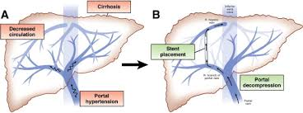
TIPS is Second-Line Treatment but Many Patients Are Not Eligible for the Procedure
Dr. Saab, UCLA
Less than 40 % are eligible for TIPS¹
Some eligible patients refuse TIPS due to high risk of hepatic encephalopathy
Relative Contraindications | Absolute Contraindications
Advanced age | Severe or poorly controlled HE
Remote history of HE | Severe liver failure
Elevated MELD | Heart failure or severe cardiac valvular insufficiency
Elevated right or left heart pressures | Marked pulmonary arterial hypertension
Extensive primary or metastatic hepatic malignancy | Unrelieved biliary obstruction
Severe uncorrectable coagulopathy | Active systemic infection or sepsis
Severe uncorrectable thrombocytopenia
Source: Saab et al 2020; (1) Copelan et al. 2014

Slide 20
Other Secondary Treatment Options are Limited and Negatively impact QoL
Dr. Saab, UCLA
Indwelling external drains
  Only SoC in patients with < 6 months to live due to tendency for infection¹
Permanent catheter
  Risk for infection, limits daily activities, stigma (stick out of skin, can’t get wet), frequently gets blocked²
Peritoneovenous shunt rarely used
  High risk of disseminated intravascular coagulation, sepsis and heart failure³
1. P. Kathpalia et al: 2 J. Caldwell et al: 3. Salerno et al 2007

Slide 21
Summary
Dr. Saab, UCLA
Treatment of recurrent or refractory ascites is major unmet need in medicine
Treatment options are limited:
    Repeat paracentesis associated with risks of infection, bleeding, and organ puncture
    TIPS can be associated with precipitation or worsening of hepatic encephalopathy and there is a possibility of liver failure in select patients
alfapump approval is a welcome addition to the available treatment options, addressing many of the key limitations
Notes:
TIPS is a procedure that involves inserting a stent to connect a branch of the portal vein to a branch of the hepatic vein to lower the portal pressure.
While it is a great option and can be very successful in reducing the need for paracentesis, unfortunately many patients are not eligible for the procedure.
[CLICK]
In fact, due to the presence of contraindications, not all patients fewer than 40% of patients with refractory or recurrent ascites are eligible.
[CLICK]
Additionally, some patients are eligible for TIPS, but refuse the procedure. Typically, this is because of the high risk of hepatic encephalopathy, which is lifestyle limiting for these patients.

Slide 22
POSEIDON & Patient Preference Studies
Dr Gijs Klarenbeek,
Chief Medical Officer

Slide 23
Implant procedure
Percutaneous Procedure in 60 – 90 minutes
Interventional Radiology (IR) procedure
Straightforward procedure with short learning curve
  Standard percutaneous techniques
  Performed in standard IR suite – standard IR equipment
Local or general anesthesia (patient/physician preference)
Existing relationship between IR and Hepatologist from TIPS
1 – 2 days hospital stay
  Post-implant follow up
  Initial pump settings

Slide 24
POSEIDON - Successful North American pivotal study
Pivotal Cohort of 40 implanted patients with recurrent or refractory ascites due to liver cirrhosis
alfapump implantation
Primary endpoint
✓
Enrolment
✓
✓
Secondary endpoints
✓
3 months
3 months
3 months
//
//
18 months
Pre-implant observation | Post-implant stabilisation | Post-implant observation | Long-term follow-up
PERFORMANCE OUTCOMES | 0 – 6 months | 0 – 24 months
Therapeutic paracentesis / month | Median of 0.0 | Median of 0.0
Freedom from LVP | 90% of patients | 80% of patients
Quality of Life: Change in SF-36 Physical Component score (higher is better) | +6.4 points⁽¹⁾ | +9.3 points⁽¹⁾
Quality of Life: Change in AscitesQ score (lower is better) | -16.8 points⁽²⁾ | -26.6 points⁽²⁾
1) median per-patient ratio of post-implant three-month observation period to the pre-implant three-month observation period with respect to number of therapeutic paracentesis (TP) is less than 0.5 (or a median reduction of at least 50%)
2) at least 50% of patients achieve a 50% reduction in the requirement for TP in the same period
Source: alfapump system SSED (summary of safety and effectiveness) PMA 230044
(1): Baseline 36.4: improvement exceeds minimally clinically important difference of 4.2 points / (2): Baseline 49.0

Slide 25
Impact on patient reported “Good Health Days”
In a true patient perspective
17 days / month
27 days / month
Pre-Implant (n=32)
Post-Implant (n=16)
Source: alfapump system SSED (summary of safety and effectiveness) PMA 230044
Good Health Day: Patient reported positive global assessment of health relative to their ascites symptoms and management
Diary selection of good, very good or excellent on a 5-point Likert scale of poor, fair, good, very good and excellent

Slide 26
Primary safety endpoint through six months consistent with expected rate
Primary Safety Endpoint Through 6 months post implant | Events | Patients with Events N = 34* n (%) | 95% CI
Primary safety endpoint | 6 | 6 (18%) | (6.8, 34.5)
Open surgical re-intervention | 0 | 0 | (0.0, 10.3)
Pump explant without replacement due to related AE | 6 | 6 (18%) | (6.8, 34.5)
Pump system related death | 0 | 0 | (0.0, 10.3)
Expected PSE rate: 15%
Source: alfapump system SSED (summary of safety and effectiveness) PMA 230044
*Per pre-specified imputation rules, patients with death or withdrawal due to unrelated cause (per CEC adjudication) are excluded from analysis (n = 6) leaving 34 evaluable mITT patients
Notes:
The primary safety endpoint was the combined rate of events due to specific pump system related AEs, including open surgical reinterventions, pump explantations without replacement, or death.
Of the 40 patients implanted with the alfapump, 34 patients were evaluable for the primary safety endpoint. There were 6 patients who exited the study early due to an UNRELATED death or explantation that were excluded from the analysis, per the predefined imputation strategy.
The primary safety endpoint rate through 6 months post-implantation for the Pivotal Cohort was 18%. This is consistent with the expected rate of 15%.
Of the 6 events that contributed to the primary safety endpoint, all were pump explantations without replacement, due to a related adverse event.
There were no pump-related deaths in the pivotal cohort through 6 months.

Slide 27
alfapump safety profile comparable to standard of care
Comparison for the six months post-implantation
Six month data⁽¹⁾ | NACSELD-III Registry Matched Patients | POSEIDON Pivotal Cohort⁽²⁾
Any Death or Hospitalization | 45.9% (17/37) | 56.8% (21/37)
Death | 10.8% (4/37) | 10.8% (4/37)
Hospitalization | 35.1% (13/37) | 45.9% (17/37)
Median # of hospitalizations (min, max) | 0 (0, 4) | 1 (0, 4)
Liver Transplant | 8.1% (3/40) | 5.4% (2/37)
NACSELD-III is a prospective cohort of outpatients with cirrhosis recruited from 10 centers across North America including patients with compensated and decompensated cirrhosis – study conducted contemporaneously with POSEIDON study
Source: alfapump SSED
(1) Deaths and serious adverse events (SAE) requiring hospitalization are presented hierarchically such that if a subject died and experienced an SAE requiring hospitalization, they are counted under “Death”.
(2) POSEIDON data are derived from adverse event data

Slide 28
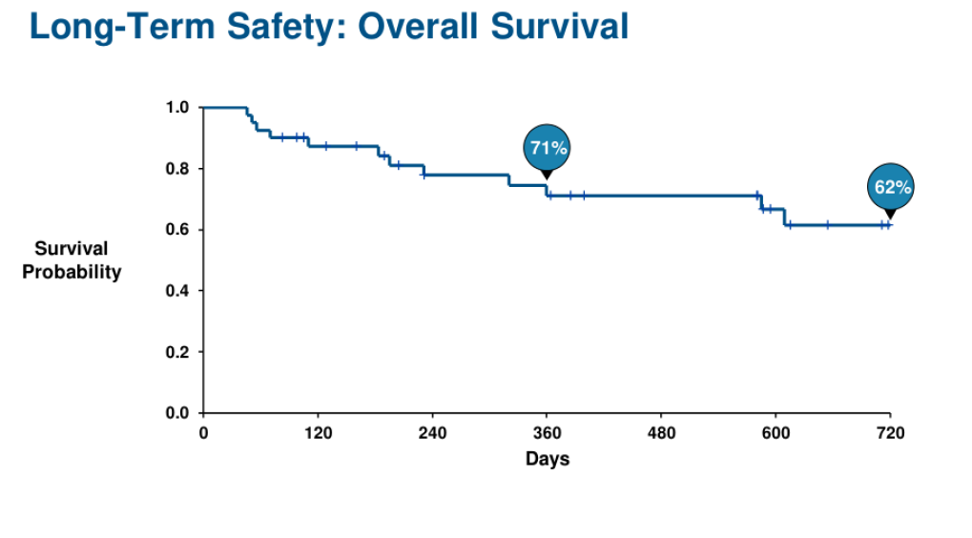
POSEIDON Overall Survival
Not a powered endpoint; Pre-specified per protocol analysis – Kaplan Meier
Source: POSEIDON clinical study report (data on file at Sequana Medical)

Slide 29
POSEIDON Overall Survival – favourable over SoC
Higher Than Expected in this Patient Population (compared to LVP), Comparable to TIPS
Source: POSEIDON clinical study report (data on file at Sequana Medical)

Slide 30
alfapump profile exceeding patient expectations
Patient preference study indicates compelling profile for alfapump based on POSEIDON outcomes
Risk tolerance (over 6 months) | Patient preference study Maximum acceptable risk | POSEIDON pivotal cohort Observed rate
Major surgery or death | >10% | 0%
Minor procedure | >35% | 20%
Serious infection or AKI resulting in hospitalization | >30% | 22.5%
Desired benefits | Patient preference study | POSEIDON pivotal cohort
Reduction in paracentesis frequency | 100% | 100% (median)
Additional ascites good health days each month | 10 | >10 (mean)
Patient Preference Study indicates US patients are willing to tolerate risks beyond those observed for the alfapump in the POSEIDON study if the need for paracentesis is reduced and/or a positive impact on health days
Source: alfapump system SSED (summary of safety and effectiveness) PMA 230044
Notes:
Question from analyst: How many ascites good health days does a typical ascites patient has each month when on standard of care? A: 17

Slide 31

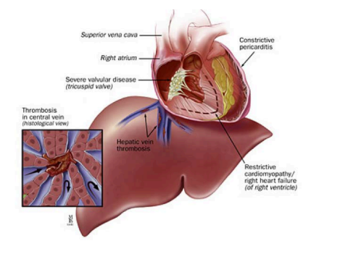
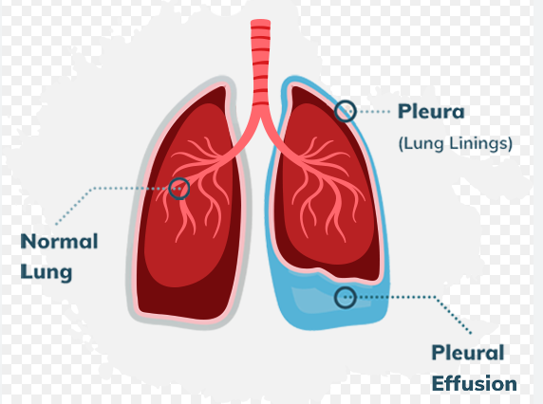
Potential Market Expansion⁽¹⁾
Opportunities for Additional Indications in Other Significant Markets
Malignant Ascites (secondary to cancer)
Breast and ovarian cancer have longest survival with ascites⁽²⁾
Severe impact on quality of life
Positive clinical experience in Europe⁽³⁾
Cardiac Ascites
Secondary to Congestive Cardiac Failure
Presents very similar to ascites due to liver cirrhosis
Pleural Effusion
Fluid in the chest cavity, secondary to cancer, heart failure or pneumonia or hepatic hydrothorax
Initial positive experience from KOLs⁽⁴⁾
1: Not included in current US indication for use for alfapump
2::Ayantunde & S. L. Parsons. Annals of Oncology 2007
3: Fotopoulou et al; BMC Palliat Care . 2019 Dec 5;18(1):109
4 Tiwari et al; ACG Case Reports Journal 11(6):p e01372, June 2024

Slide 32
What the POSEIDON data means for US patients and physicians & Experiences from the POSEIDON study
Dr Pagadala,
Methodist Dallas Medical Center

Slide 33
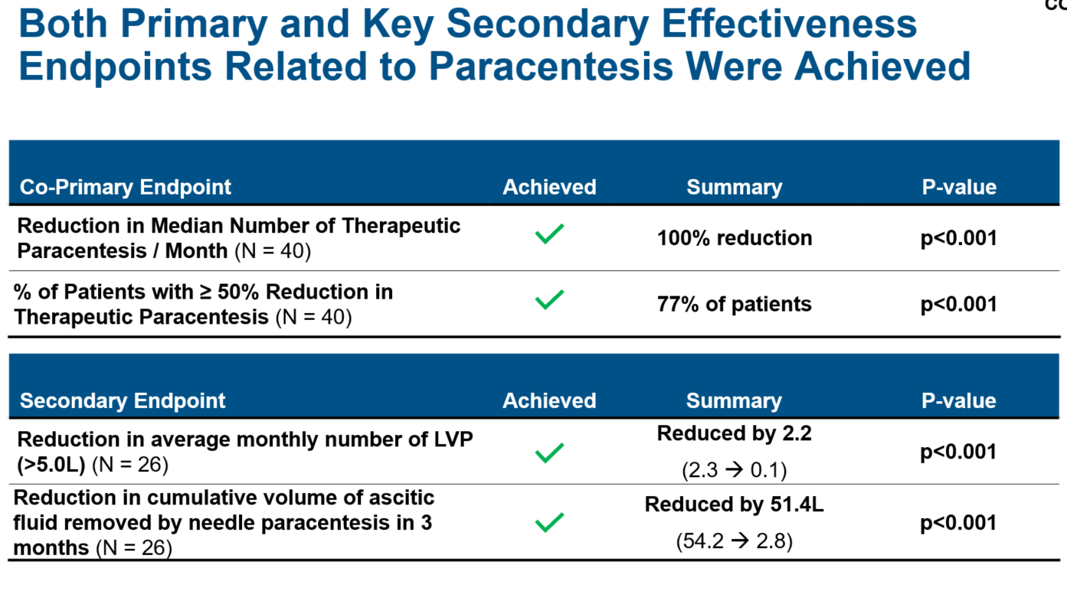
Effectiveness demonstrated in POSEIDON
Dr. Pagadala, Methodist Dallas Medical Center
Impact on patients – caregivers – physicians / hospital
Source: POSEIDON clinical study report (data on file at Sequana Medical)

Slide 34
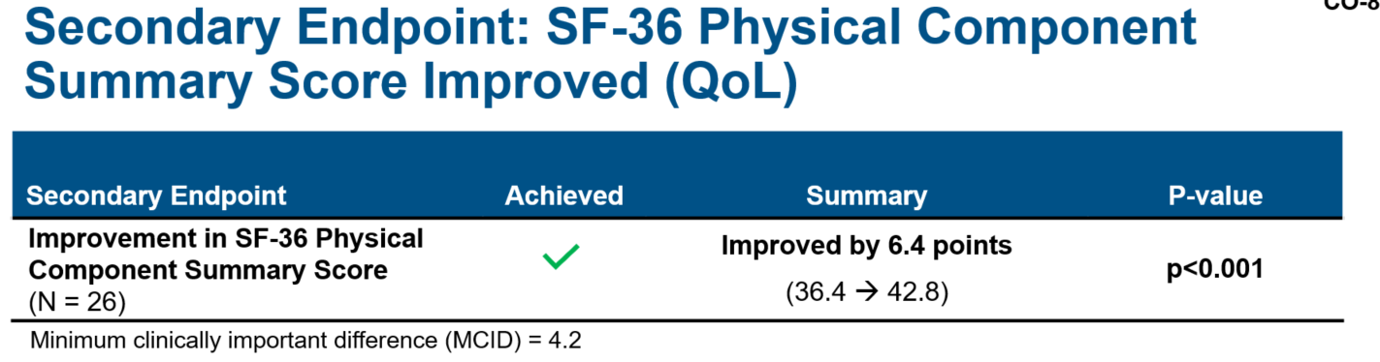
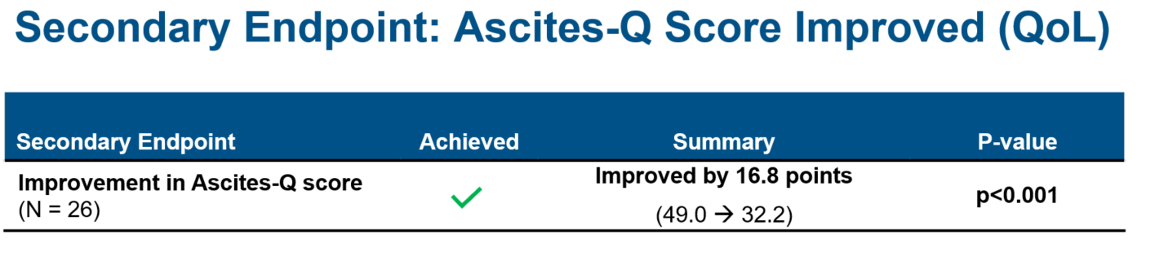
Impact on Quality of Life
Dr. Pagadala, Methodist Dallas Medical Center
Patient Perspective beyond numbers as outcome of a Questionnaire
Source: POSEIDON clinical study report (data on file at Sequana Medical)

Slide 35
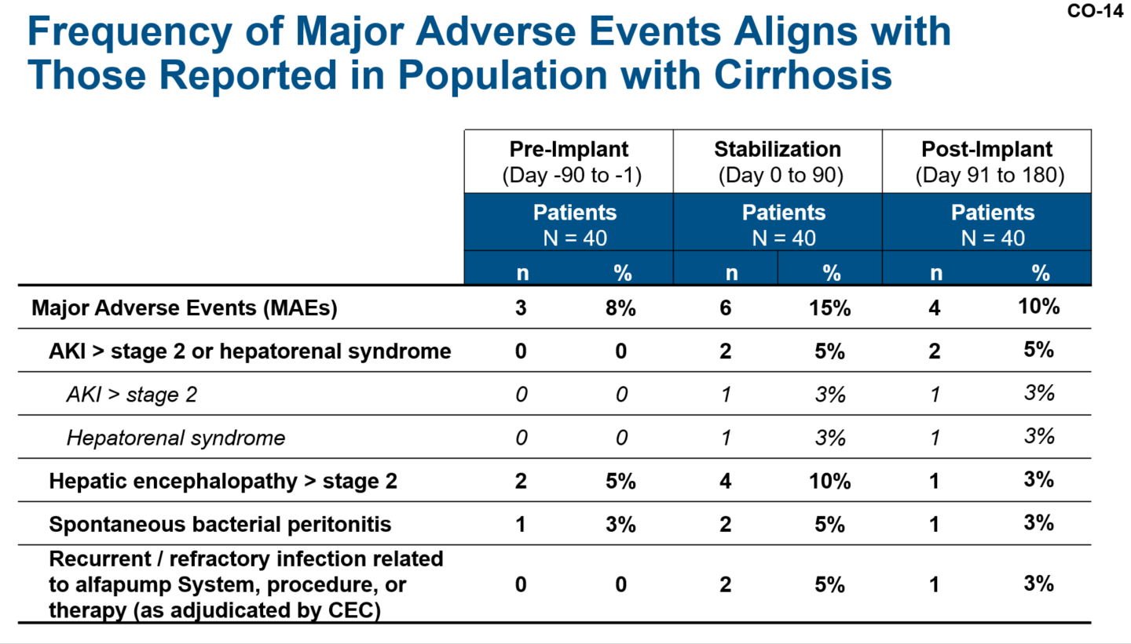
Safety - Complications
Dr. Pagadala, Methodist Dallas Medical Center
As expected for this patient population – manageable
Source: POSEIDON clinical study report (data on file at Sequana Medical)

Slide 36
Center Experience
Dr. Pagadala, Methodist Dallas Medical Center
From POSEIDON clinical study
Build alfapump Team
Collaboration between departments
  Hepatology
  Interventional Radiology
  Other Medical and Paramedical Staff
Learning curve
  Implantation – early post-implant period
  Long term follow up

Slide 37
US Market Opportunity & Commercial Roll-Out Plans
Martijn Blom,
Chief Commercial Officer

Slide 38
$2bn US market for alfapump in 2025; 9% CAGR⁽¹⁾
$500 million Priority One market with highly attractive dynamics for the alfapump
Recurrent and refractory ascites prevalence (US)
170k
155k
Priority 3⁽²⁾
3-5 paracenteses / year
Priority 2⁽²⁾
6-11 paracenteses / year
Priority 1⁽²⁾
12+ paracenteses / year
142k
9% CAGR
130k
Prioritisation Factors:
Impact on patient QOL
Current cost to payors
Burden on hospital resources
Likelihood to be TIPS exclusions or TIPS failures
116k
105k
96k
Patients (thousands)
88k
75k
81k
70k
¹ Based on US market assessment conducted by highly experienced international consulting group, estimating 130,000 patients with recurrent or refractory ascites in US by 2032 and based on proposed price of $30k per alfapump;
² Based on US and Canada market assessment by international consulting group, using claims analysis for commercial and CMS (Center for Medicare and Medicaid Services) patients requiring paracentesis procedure with liver disease diagnosis codes; Medicare Inpatient & Outpatient Hospital Standard Analytical Files 2019.CMS, Baltimore, MD. www.cms.hhs.gov

Slide 39
Attractive pricing with derisked reimbursement
Existing DRG & CPT III codes - NTAP and TCET benefit from Breakthrough Device Designation
Coding – Strong position from existing DRG codes and Breakthrough Designation
Existing US hospital DRG payment for alfapump procedure*
Breakthrough designation enables higher payments via NTAP (applied for, and expected in 10/25)
Supports alfapump ASP of $30K (80% gross margin)
CPT III codes granted
Coverage – Prior Approval from Specialist Centers With High Medical Need
High pre-approval potential from targeted hospitals
New Federal Regulation enforces rapid decision making
*On the basis of existing ICD-10 codes issued for the alfapump (OW1G3J6 & OJH80YZ), the likely DRG coding will be 423 “OTHER HEPATOBILIARY OR PANCREAS O.R. PROCEDURES”,
DRG: Diagnosis Related Group; NTAP: New Technology Add-On Payment; CPT: Current Procedural Terminology;

Slide 40



US – Go direct to 90 liver transplant centers
Highly efficient approach to target doctors and patients – driven by treatment guidelines
Cover 95% of liver transplants
Small focused commercial team
Source: Organ Procurement & Transplantation Network, US Dept of HHS (optn.transplant.hrsa.gov)

Slide 41
Commercial Roll-Out – Focus on High Quality Outcomes
Driven by product availability, recruitment / training of Sequana team and onboarding of new sites
“Soft Commercial Launch”: H2 2025 – Q1 2026
  Limited initial production availability of key supplier; forecasting 80-100 systems available
  Targeting up to seven centers – sites identified and preparations underway
  Training of Sequana implanting team
  Training of centers and refining “onboarding” activities (contracting, training etc)
  Optimising the process for Full Commercial Launch
“Full Commercial Launch”: Q2 2026 onwards
  Full production availability planned
  Growth driven by:
    Increasing penetration of existing centers (ie more implants / quarter)
    Addition of ~5 new centers every quarter, targeting all 90 transplant centers by end of 2030
  Addition of new centers requires recruitment and training of Sequana implanting team, and new centers to be onboarded

Slide 42
PMA & Breakthrough Device Designation Are Key
Combination creates real challenges to entry of competing products
PMA: (granted to alfapump system in 2024)
Evaluation of safety and efficacy of Class III devices; most stringent regulatory category – technical, non-clinical and clinical components
Requires collection of data so our data & studies cannot be referenced by a competitor & does not create a 510(k) pathway
Significant time, resource & cost barrier for any new entrants to conduct new studies
Recruiting for study with unapproved product likely to be harder now alfapump has US approval
Breakthrough Device Designation: (granted to alfapump system in 2019)
Medical devices [and device-led combination products] that provide for more effective treatment or diagnosis of life-threatening or irreversibly debilitating diseases or conditions
Expedites the development and review of devices, incl. pre/postmarket balance of data collection, and efficient and flexible clinical study design – POSEIDON study design was major advantage
Now alfapump is approved, can a competitor obtain breakthrough device designation and resulting benefits in trial design? if not, will they likely require longer and more complex studies?

Slide 43
Wrap-Up
Ian Crosbie,
CEO

Slide 44
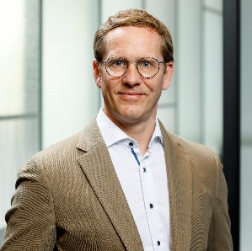
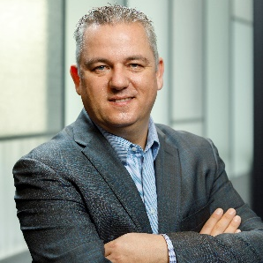


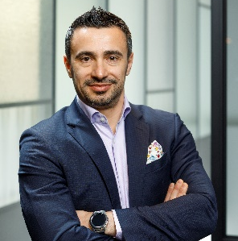
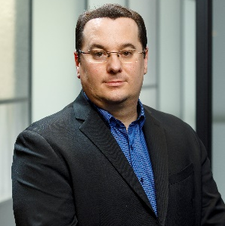
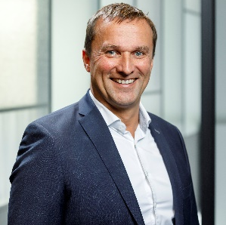
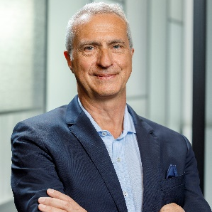
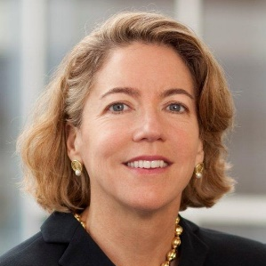
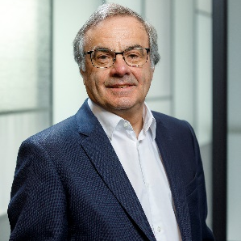

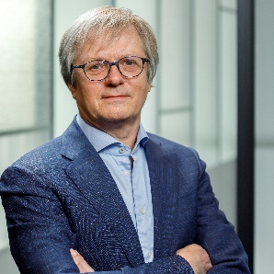

Highly experienced leadership team
Supported by committed shareholders
Executive team:
Ian Crosbie
Chief Executive Officer
Gijs Klarenbeek
Chief Medical Officer
Martijn Blom
Chief Commercial Officer
Kirsten Van Bockstaele
Chief Financial Officer
Dragomir Lakic
VP Manufacturing
Timur Resch
Global VP QM/QA/RA
Andreas Wirth
VP Engineering
Board of Directors:
Pierre Chauvineau
Chairman
Alex Clyde
Director
Wim Ottevaere
Director
Jackie Fielding
Director
Rudy Dekeyser
Director
Ids van der Weij
Director
Ian Crosbie
Chief Executive Officer

Slide 45
alfapump – highly attractive US opportunity
US PMA approval in large and growing market with attractive dynamics and direct specialty sales model
Recurrent and Refractory Liver Ascites - $2 billion market with 9% CAGR driven by MASH/NASH & alcoholic liver disease
Potential to Transform Underserved Market – Clear unmet clinical needs from standard of care that is not defended by commercial player, and no competitive devices in development
Strong Clinical Message – POSEIDON pivotal study clearly met efficacy and safety end points
Derisked Reimbursement – Existing coding, together with NTAP and focus on specialist centers
Direct Specialty Sales Model Launching H2 2025 - Small specialty salesforce focused on liver transplant centers
Positive Market Feedback – Clear need for improved treatment options from clinicians & patients
Platform for Sustained Market Leadership – Real long term barriers to direct competitors from PMA and FDA Breakthrough Device Designation, plus granted IP and extensive know-how
Established and Experienced Leadership – Derisking scale-up & commercial rollout

Slide 46
Q&A

Slide 47
Thank You
IR@sequanamedical.com
T: +32 (0)9 496 17 27

